Slide 1
INF10025
Data Management and Analytics
Week 02 – Part 1
Multiple tables and relationships

Slide 2
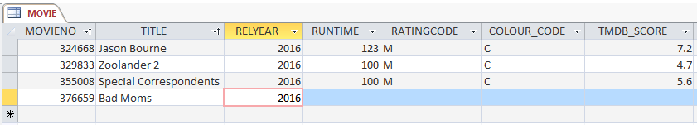
Adding a new record to the Movie Table
Last lecture we created a Movie table. To add a new movie we:
  Open the Movie Datasheet view
  Click on the * at the bottom left of the view
  Type in the details
The Datasheet view:
  Not end-user friendly. You would not expect end-users/customer to use a datasheet.
  If this was an employee table, it would contain personal details. The end-user could see data about other employees
  Easy to delete data in one row / multiple rows very easily (by mistake)

Slide 3
The Movie Table
The Movie table has a field called RatingCode.
What is a "PG" rated movie?
  RatingName: "PARENTAL GUIDANCE"
  Description: "Parental guidance recommended for persons under 15 years."
What is a "MA" rated movie?
  RatingName: "MATURE ACCOMPANIED (15+)"
  Description: "Persons under 15 years must be accompanied by a mature adult."
movieNo | title | relyear | runtime | ratingcode
15 | The Hunger Games | 2012 | 142 | PG
41 | Silver Linings Playbook | 2012 | 122 | MA
135 | The Hangover | 2009 | 100 | MA
156 | X-Men Days of Future Past | 2014 | 101 | PG

Slide 4
Too much in one table
Imagine, we add rating details to the Movie table
movieNo | title | relyear | runtime | ratingcode | ratingName | ratingDescription
15 | The Hunger Games | 2012 | 142 | PG | PARENTAL GUIDANCE | Parental guidance recommended for persons under 15 years
41 | Silver Linings Playbook | 2012 | 122 | MA | MATURE ACCOMPANIED (15+) | Persons under 15 years must be accompanied by a mature adult
135 | The Hangover | 2009 | 100 | MA | MATURE ACCOMPANIED (15+) | Persons under 15 years must be accompanied by a mature adult
156 | X-Men Days of Future Past | 2014 | 101 | PG | PARENTAL GUIDANCE | Parental guidance recommended for persons under 15 years
What problems could arise?
Solution: create a separate table for Ratings

Slide 5
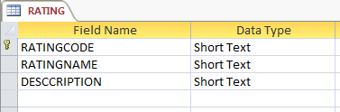
Movies and Rating Codes
This Rating information should be stored in our Database in a Table.
RATINGCODE | RATINGNAME | DESCRIPTION
G | General | Suitable for all ages
PG | Parental Guidance | Recommended for mature audiences 15 years and over
M | Mature (15+) | Persons under 15 years must be accompanied by a mature adult
MA | Mature Accompanied (15+) | Parental guidance recommended for persons under 15 years
R | Restricted (18+) | Restricted to mature adults 18 years and over

Slide 6
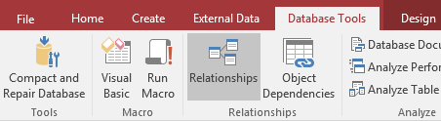
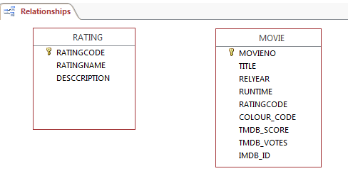

Movies and Rating Codes
When more than one table exists in a Database, we should open
the Relationships Manager
We add the tables to the
manager window

Slide 7
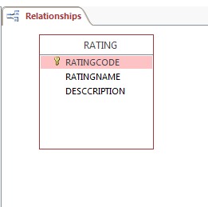
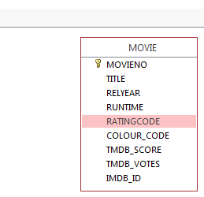
Movies and Rating Codes
There is a connection between Movie and Rating.
Drag the field RATINGCODE in the movie table and drop it over RATINGCODE in the Rating table

Slide 8
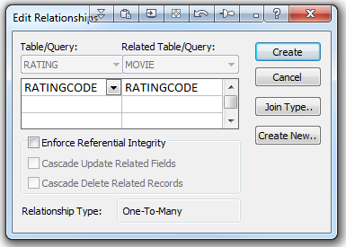
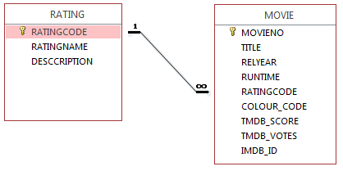
Movies and Rating Codes
This creates a Many to One relationship
The movie.ratingcode field is referred to as
a Foreign Key.
Each Foreign Key value in the Movie
table references a Primary Key value
in the Rating Table

Slide 9
Movies and Rating Codes
Each Foreign Key value in
the movie table
references a Primary
Key value in the Rating
table
movieNo | title | relyear | runtime | Foreign Key ratingcode
15 | The Hunger Games | 2012 | 142 | PG
41 | Silver Linings Playbook | 2012 | 122 | MA
135 | The Hangover | 2009 | 100 | MA
156 | X-Men Days of Future Past | 2014 | 101 | PG
Primary Key ratingcode | RatingName | Description
G | General | Suitable for all ages
PG | Parental Guidance | Recommended for mature audiences 15 years and over
M | Mature (15+) | Persons under 15 years must be accompanied by a mature adult
MA | Mature Accompanied (15+) | Parental guidance recommended for persons under 15 years
R | Restricted (18+) | Restricted to mature adults 18 years and over

Slide 10
Movies and Rating Codes
This is a Many to One
relationship.
Many FKs refer to
one PK.
movieNo | title | relyear | runtime | Foreign Key ratingcode
15 | The Hunger Games | 2012 | 142 | PG
41 | Silver Linings Playbook | 2012 | 122 | MA
135 | The Hangover | 2009 | 100 | MA
156 | X-Men Days of Future Past | 2014 | 101 | PG
Primary Key ratingcode | RatingName | Description
G | General | Suitable for all ages
PG | Parental Guidance | Recommended for mature audiences 15 years and over
M | Mature (15+) | Persons under 15 years must be accompanied by a mature adult
MA | Mature Accompanied (15+) | Parental guidance recommended for persons under 15 years
R | Restricted (18+) | Restricted to mature adults 18 years and over

Slide 11
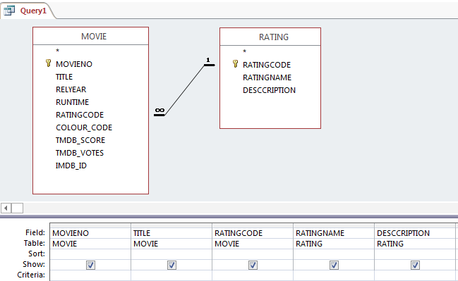
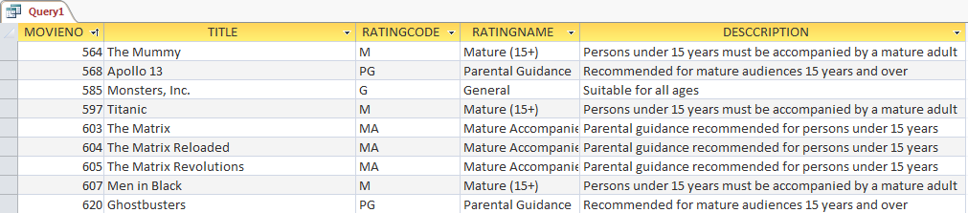
Query based on a two table relationship
Now design a new Query using both the Movie and Rating tables.
As you add the tables to the query, the relationship is shown.
This query has data from both tables. The query matches every FK value in the Movie table with a PK value in the Rating table.

Slide 12
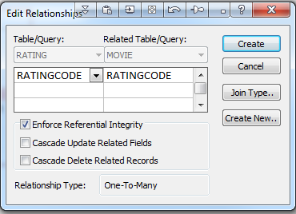
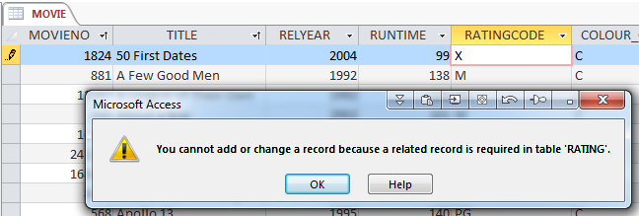
Referential Integrity
The option to Enforce Referential Integrity
is a constraint that the RDBMS performs to
only allow values in the movie.ratingcode
field that match an existing value in the
rating table
Entering a movie.ratingcode value of 'X'
would cause a referential integrity error.

Slide 13
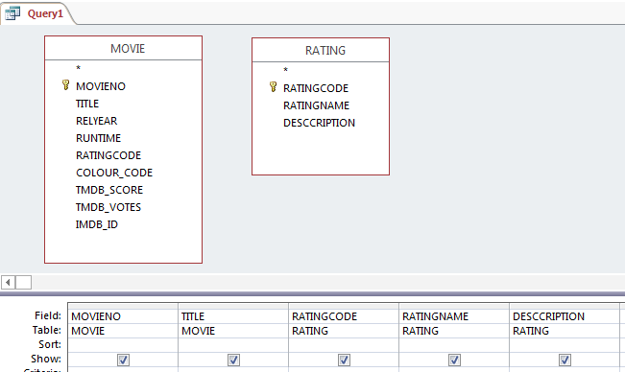
Be aware of unrelated tables
Imagine that you did not create the relationship between the Movie and Rating tables.
They are simply two unrelated tables.
When you create a query, the RDBMS does not know what these tables have in common.
There is no connection between the rating codes in the two tables (at least that's what the RDBMS thinks).

Slide 14
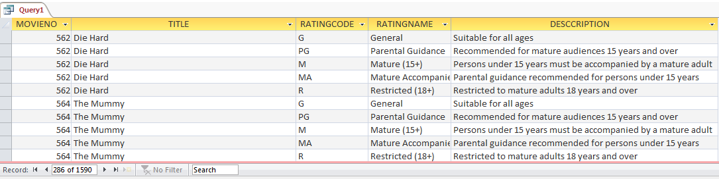
Be aware of Cartesian Products
If you run a query that uses data from both unrelated tables, then a 'cartesian product' is created. Every row in movie table matches every row in the ratings table.
318 movies * 5 ratings = 1590 rows! Utterly useless. Can be very slow to create. AVOID

Slide 15


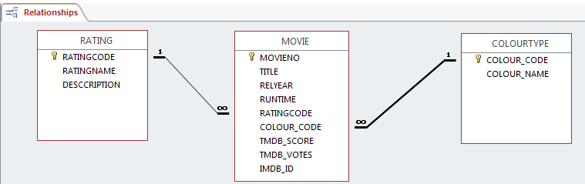
Movie Table / ColourType relationship
The Movie Table has a field called Colour_Code
Imagine that we create a table named ColourType.
This must be added to the Relationship Manager.
We have two Many to One relationships.

Slide 16
Actor data
The Movie Database requires information about actors.
  The following data about actors will be stored:
actorNo | firstname | surname | gender
72129 | Jennifer | Lawrence | F
51329 | Bradley | Cooper | M
1245 | Scarlett | Johansson | F
6968 | Hugh | Jackman | M

Slide 17
Actor data
So now we have data about Movies and Actors
The next obvious task is to nominate
the actors who appear in each movie
movieNo | title | relyear | runtime | ratingcode
70160 | The Hunger Games | 2012 | 142 | PG
82693 | Silver Linings Playbook | 2012 | 122 | MA
18785 | The Hangover | 2009 | 100 | MA
127585 | X-Men Days of Future Past | 2014 | 101 | PG
actorNo | firstname | surname | gender
72129 | Jennifer | Lawrence | F
51329 | Bradley | Cooper | M
1245 | Scarlett | Johansson | F
6968 | Hugh | Jackman | M

Slide 18

ACTOR, MOVIE relations
Bradley Cooper acted in the movie titled "Silver Linings Playbook"
I.e. actorNo 51329 acted in movieNo 82693
Jennifer Lawrence acted in the movie "Silver Linings Playbook"
I.e. actorNo 72129 acted in movieNo 82693
Jennifer Lawrence acted in the movie "The Hunger Games"
I.e. actorNo 72129 acted in movieNo 70160
We can store this information using these codes
Each row shown here represents one actor
cast into one movie
actorNo | movieNo
51329 | 82693
72129 | 82693
72129 | 70160

Slide 19
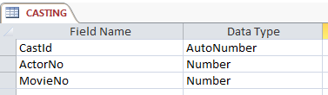
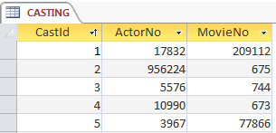
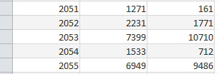
Casting table
We will create a table called Casting.
Each record in this table represents One Actor in One Movie
  The CastId is simply a auto generated number to give each row a unique identity (a primary key value).

Slide 20
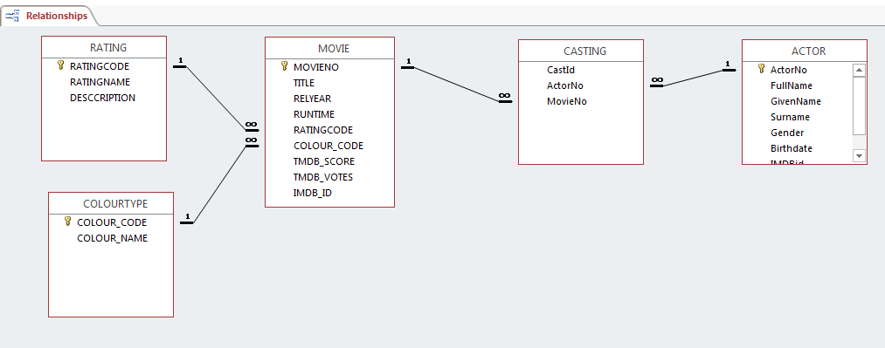
Relationship Diagram
This is an updated Relationship Diagram. It looks complicated.
However, it is simply a collection of multiple Many to One relationships.
Each relationship has a Foreign Key that references a Primary Key

